Slide 2

The Big ‘‘Why’’
    What do you understand by Service Catalogue?
    What is Service Catalogue Management?

Slide 3

ITIL defines a Service Catalogue as:
“A database or structured document with information about all live IT services, including those available for deployment. The service catalogue is part of the service portfolio and contains information about two types of IT service: customer-facing services that are visible to the business; and supporting services required by the service provider to deliver customer-facing services.”
(Source: Service Design book)
ITIL defines Service Catalogue Management (SCM) as:
“The process responsible for providing and maintaining the service catalogue and for ensuring that it is available to those who are authorized to access it.”
(Source: Service Design book)

Slide 4

Overview
    Indispensable tool for any organization.
    Storehouse for all information relating to the Services that the business offers to its customers.
    Serves as a handy reference for everyone in the organization to obtain consistent, up-to-date information on all current Service offerings.
  The Service Catalogue Management (SCM) process ensures that the information contained within the Service Catalogue is accurate, regularly updated, and readily available to those who need it.
Service Catalogue

Slide 5

Unit Learning Objectives:
    Understand the importance of the SCM process in the
    Service Lifecycle.
    Understand the goals and objectives of the process.
    Understand the scope of the process.
    Learn how Service Catalogue adds value to the business.
    Understand the policies, principles, and basic concepts of the process.
    Identify the process activities, methods, and techniques of SCM.
    Identify the triggers, inputs, and outputs of SCM.
    Understand the key metrics and Critical Success Factors (CSFs) associated with the process.
    Identify the challenges and risks of the process.
    Understand the steps to produce a Service Catalogue .

Slide 6
Topics Covered in This Unit:
    3.1 Importance of the Service Catalogue to the Service Lifecycle and Its Interface to the Service Portfolio
    3.2 Purpose and Objectives
    3.3 Scope of the Process
    3.4 Value to the Business
    3.5 Policies, Principles, and Basic Concepts
    3.6 Process Activities
    3.7 Triggers, Inputs, Outputs, and Interfaces with Other Processes
    3.8 Information Management
    3.9 Critical Success Factors and Key Performance Indicators
    3.10 Challenges and Risks
    3.11 Production of a Service Catalogue
    3.12 Sample Test Question

Slide 7

3.1
Importance of the Service Catalogue to the Service Lifecycle and Its Interface to the Service Portfolio
3.2
Purpose and Objectives
3.3
Scope of the Process
3.4
Value to the Business
Concept Jog
  Let us discuss the following:
    Why do you think it is important to have a good Service Catalogue within your own organization?
  Note:
    You may choose to take notes as this discussion progresses.
    Attempting to connect the concept to practical specifics from your organization will help you understand the concept, and eventually support your ability to succeed at the Exam or apply the concept correctly within your organization.

Slide 8
3.1
Importance of the Service Catalogue to the Service Lifecycle and Its Interface to the Service Portfolio
3.2
Purpose and Objectives
3.3
Scope of the Process
3.4
Value to the Business
Importance of the Service Catalogue
Sale and delivery of IT services
Service order and demand channeling mechanism
Configurable solutions for customers from one or more services
Definition and communication of the policies, guidelines, and accountability
Service Provider
Service Catalogue
Operational Service 1
Operational Service 2
. . . . . .
View of current Service capability
Details of each Service and its components
Pricing and service-level commitments
Terms and conditions for service provision
Information on sale and delivery
Request fulfillment procedure
Customer

Slide 9
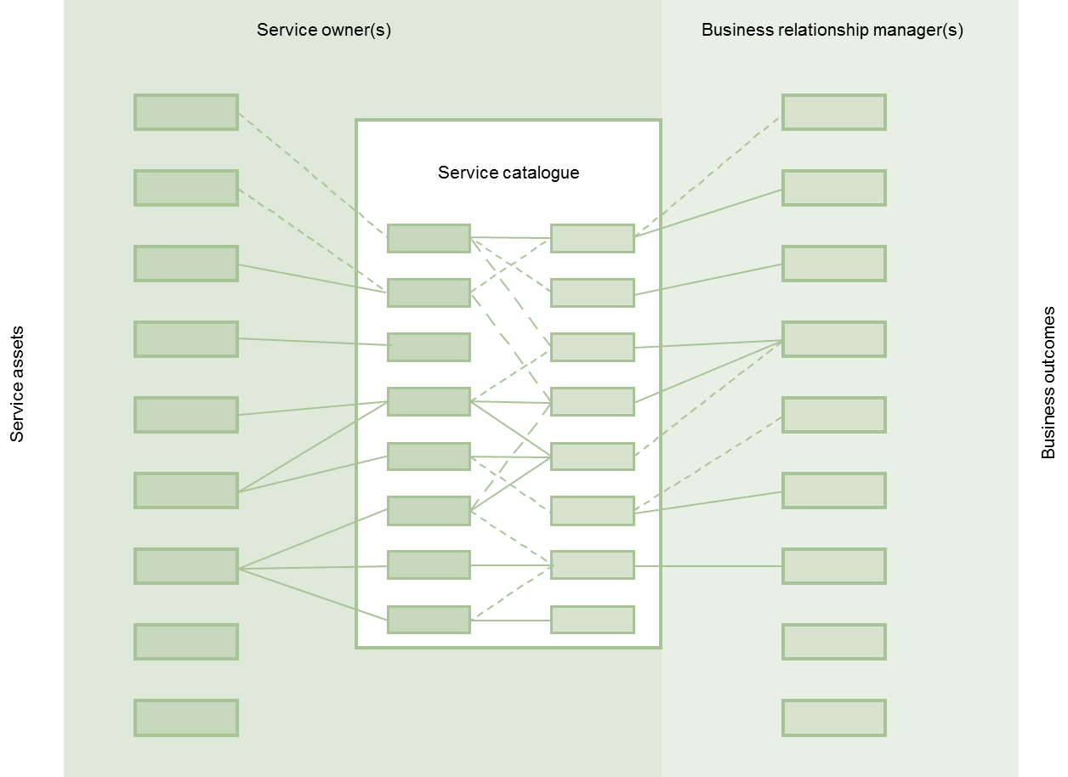
3.1
Importance of the Service Catalogue to the Service Lifecycle and Its Interface to the Service Portfolio
3.2
Purpose and Objectives
3.3
Scope of the Process
3.4
Value to the Business
The Service Catalogue and Linkages between Services and Outcomes
Adapted from The service catalogue and linkages between services and outcomes © Crown Copyright 2011 Reproduced under licence from the Cabinet Office

Slide 10

3.1
Importance of the Service Catalogue to the Service Lifecycle and Its Interface to the Service Portfolio
3.2
Purpose and Objectives
3.3
Scope of the Process
3.4
Value to the Business
Brainstorm
Let us brainstorm on the following:
    Describe the usefulness of a Service Catalogue to an IT organization.
  Note:
    Write your response in the space provided in your Workbook.
    Brainstorm!

Slide 11
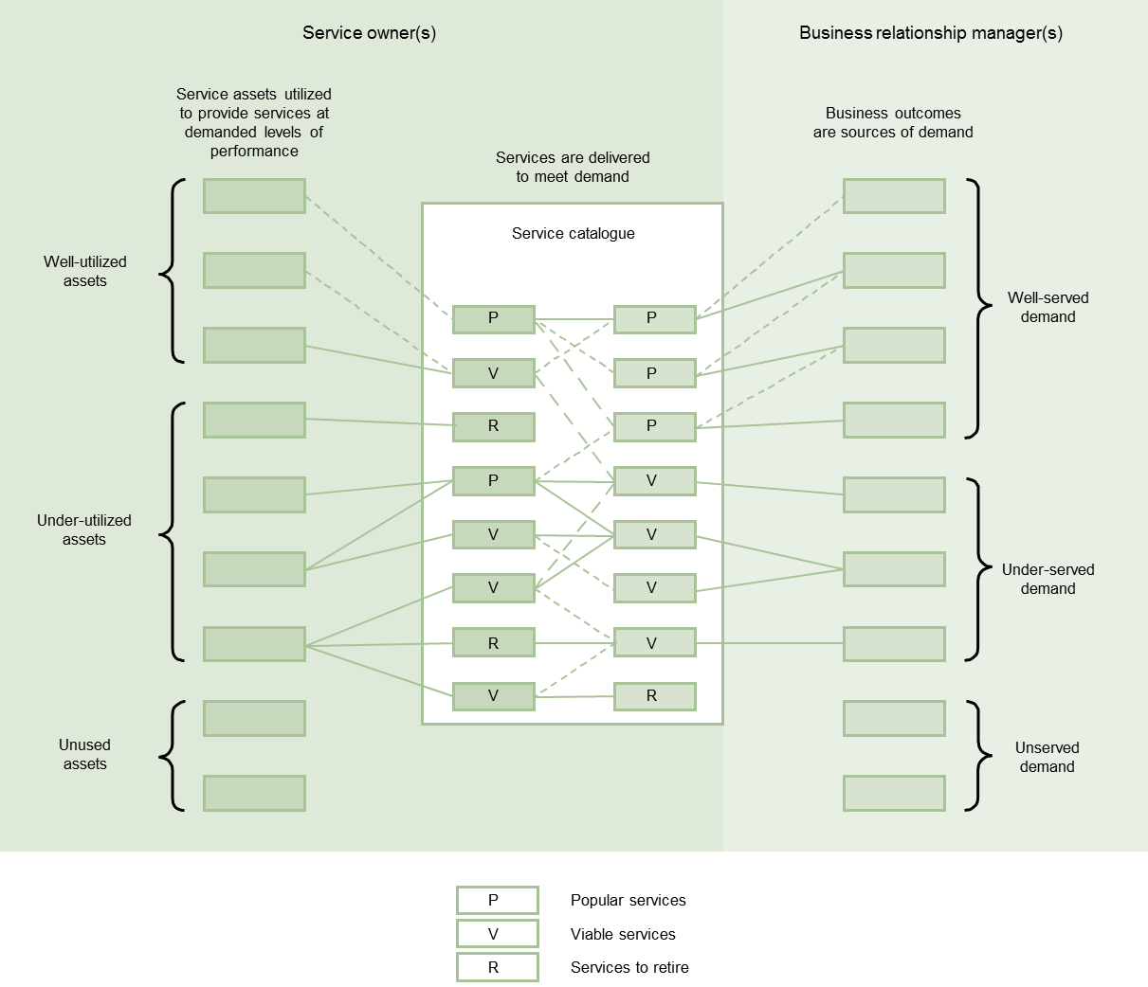

3.1
Importance of the Service Catalogue to the Service Lifecycle and Its Interface to the Service Portfolio
3.2
Purpose and Objectives
3.3
Scope of the Process
3.4
Value to the Business
Service Catalogue and Demand Management
Adapted from Service catalogue and demand management © Crown Copyright 2011 Reproduced under licence from the Cabinet Office
Zoomed graphic provided in Appendix F.

Slide 12

3.1
Importance of the Service Catalogue to the Service Lifecycle and Its Interface to the Service Portfolio
3.2
Purpose and Objectives
3.3
Scope of the Process
3.4
Value to the Business
Service Portfolio and Service Catalogue
Service portfolio
Service Catalogue(s)
Opportunity
Services
Value proposition
Supported levels of performance
Business outcomes supported
Policies
Business cases
Minimum requirements
Priorities
Ordering and request
Risks
Support terms and conditions
Offerings and packages
Dependencies
Investments required
Points of contact
Ongoing costs and pricing
Pricing and charging
Adapted from Service portfolio and service catalogues © Crown Copyright 2011 Reproduced under licence from the Cabinet Office

Slide 13

3.1
Importance of the Service Catalogue to the Service Lifecycle and Its Interface to the Service Portfolio
3.2
Purpose and Objectives
3.3
Scope of the Process
3.4
Value to the Business
Round-Robin Discussion
    When you look to your own organization, how are present contractual commitments, new Service developments, and ongoing Service Improvement Plans (SIPs) registered?
    What provides control over third-party Services? Is there a central repository to register, control, and manage these Services?
    What advantages do you see in using a Service Portfolio approach in your own organization?
    To secure the financial viability of your organization, you should have the right mix of Services in the Service Pipeline and Service Catalogue. When you look at your own organization, what do you think of this mix?
    When you look at your own organization, how would you initiate SPM?
    What type of information from the Service Portfolio would be used by customers, users, staff, and other members of the organization?

Slide 14
3.1
Importance of the Service Catalogue to the Service Lifecycle and Its Interface to the Service Portfolio
3.2
Purpose and Objectives
3.3
Scope of the Process
3.4
Value to the Business
Round-Robin Discussion (Contd.)
    Which of the content items in the Service Portfolio, as listed below, should be used in the Service Catalogue?
      “Service name
      Service description
      Service status
      Service classification and criticality
      Applications used
      Data and/or data scheme used
      Business processes supported
      Business owners
      Business users
      IT owners
      Service warranty level, SLA and SLR references
      Supporting services
      Supporting resources
      Dependent services

Slide 15
3.1
Importance of the Service Catalogue to the Service Lifecycle and Its Interface to the Service Portfolio
3.2
Purpose and Objectives
3.3
Scope of the Process
3.4
Value to the Business
Round-Robin Discussion (Contd.)
      Supporting OLAs, contracts and agreements
      Service costs
      Service charges (if applicable)
      Service revenue (if applicable)
      Service metrics”
  (Source: Service Design book)
Note:
    Analyze the context provided on the slide.
    Write your response in the space provided in your Workbook.
    Discuss!

Slide 16
3.1
Importance of the Service Catalogue to the Service Lifecycle and Its Interface to the Service Portfolio
3.2
Purpose and Objectives
3.3
Scope of the Process
3.4
Value to the Business
  “The purpose of the service catalogue management process is to provide and maintain a single source of consistent information on all operational services and those being prepared to be run operationally, and to ensure that it is widely available to those who are authorized to access it.”
  (Source: Service Design book)
“The objectives of the service catalogue management process are to:
Manage the information contained within the service catalogue
Ensure that the service catalogue is accurate and reflects the current details, status, interfaces and dependencies of all services that are being run, or being prepared to run, in the live environment, according to the defined policies
Ensure that the service catalogue is made available to those approved to access it in a manner that supports their effective and efficient use of service catalogue information
Ensure that the service catalogue supports the evolving needs of all other service management processes for service catalogue information, including all interface and dependency information.”
(Source: Service Design book)
Purpose
Objectives

Slide 17
3.1
Importance of the Service Catalogue to the Service Lifecycle and Its Interface to the Service Portfolio
3.2
Purpose and Objectives
3.3
Scope of the Process
3.4
Value to the Business
Scope of SCM
    Contributes to the definition of Services and Service Packages
    Develops and maintains Service and Service Package Descriptions appropriate for the Service Catalogue
    Produces and maintains an accurate Service Catalogue
    Provides interfaces, dependencies and consistency between the Service Catalogue and the overall Service Portfolio
    Provides interfaces and dependencies between all Services and supporting Services within the Service Catalogue and the Configuration Management System (CMS)
    Provides interfaces and dependencies between all Services, and supporting components and Configuration Items (CIs) within the Service Catalogue and
    the CMS.

Slide 18

3.1
Importance of the Service Catalogue to the Service Lifecycle and Its Interface to the Service Portfolio
3.2
Purpose and Objectives
3.3
Scope of the Process
3.4
Value to the Business
Value to the Business
Improvement
Relationships between the customer and Service Provider
Service Provider’s focus on customer outcomes
Efficiency and effectiveness of other Service Management processes
Knowledge, alignment, and focus on “business value”

Slide 19
3.5
Policies, Principles, and Basic Concepts
3.6
Process Activities
3.7
Triggers, Inputs, Outputs, and Interfaces with Other Processes
3.8
Information Management
Policies
Develop clearly defined policies for SCM.
Policies should exist relating to:
    The Services that are recorded in the Service Catalogue
    Details of the Services that are recorded in the Service Catalogue. This includes what statuses are recorded for each of the Services.
    Details of responsibilities for each section of the overall Service Portfolio
    The scope of each of the constituent sections. This includes policies regarding:
      When a Service is published in the Service Catalogue
      When a Service will be removed from the Service Catalogue and appear only in the retired Services section of the Service Portfolio.

Slide 20
3.5
Policies, Principles, and Basic Concepts
3.6
Process Activities
3.7
Triggers, Inputs, Outputs, and Interfaces with Other Processes
3.8
Information Management
Defining Services
Anticipated uses for the Service Catalogue
Influencing Factors
Current organizational culture, practices, and maturity levels
Policy to define a Service
Target audiences of the Service Catalogue

Slide 21
3.5
Policies, Principles, and Basic Concepts
3.6
Process Activities
3.7
Triggers, Inputs, Outputs, and Interfaces with Other Processes
3.8
Information Management
Different Types of Service
Business process 1
Business process 2
Business process 3
Customer i
Customer ii
Customer iii
Customer iv
The service catalogue
SLA
SLA
SLA
SLA
Customer-
facing services
Service A
(core service)
Service B
(enhancing service)
Service C
(core service)
Service D
(core service)
Supporting
services
Service a
Service b
Service c
Service d
Service e
Adapted from Types of service in a service catalogue © Crown Copyright 2011 Reproduced under licence from the Cabinet Office

Slide 22
3.5
Policies, Principles, and Basic Concepts
3.6
Process Activities
3.7
Triggers, Inputs, Outputs, and Interfaces with Other Processes
3.8
Information Management
Service Catalogue Uses
Customers
Service Catalogue
Staff members
Users/Individual Service consumers

Slide 23

3.5
Policies, Principles, and Basic Concepts
3.6
Process Activities
3.7
Triggers, Inputs, Outputs, and Interfaces with Other Processes
3.8
Information Management
Discussion
    Define “What is a Service?” in an IT organization.
    Describe the steps to lay out hierarchy of Services.
    Why the Service Catalogue is a Key Document?
  Note:
    Write your response in the space provided in your Workbook.
    Discussion!

Slide 24
3.5
Policies, Principles, and Basic Concepts
3.6
Process Activities
3.7
Triggers, Inputs, Outputs, and Interfaces with Other Processes
3.8
Information Management
Service Catalogue Structure
The service catalogue
Business
process 1
Business
process 2
Business
process 3
Business/customer
service catalogue view
Service A
Service B
Service C
Service D
Service E
Service 1
Service 2
Service 3
Service 4
Service 5
Service 6
Technical/supporting service catalogue view
Links to related
information
Service assets/configuration records
Adapted from A two-view service catalogue © Crown Copyright 2011 Reproduced under licence from the Cabinet Office
Key
= Customer-facing services
= Supporting services

Slide 25
3.5
Policies, Principles, and Basic Concepts
3.6
Process Activities
3.7
Triggers, Inputs, Outputs, and Interfaces with Other Processes
3.8
Information Management
The service catalogue
Wholesale service catalogue view
Retail service catalogue view
Wholesale
customer 1
Wholesale
customer 2
Retail
customer 1
Retail
customer 2
Service A
Service B
Service C
Service D
Service E
Service 1
Service 2
Service 3
Service 4
Service 5
Service 6
Supporting service catalogue view
Links to related
information
Service assets/configuration records
Key
= Customer-facing services
= Supporting services
Adapted from A three-view service catalogue © Crown Copyright 2011 Reproduced under licence from the Cabinet Office

Slide 26
3.5
Policies, Principles, and Basic Concepts
3.6
Process Activities
3.7
Triggers, Inputs, Outputs, and Interfaces with Other Processes
3.8
Information Management
Process Activities
Documenting Service definitions
Interfacing with Business Relationship Management and SLM
SCM Process Activities
Interfacing with Service Portfolio Management
Interfacing with support teams, suppliers, and Service Asset and Configuration Management
Producing and Maintaining the Service Catalogue
Interfacing with the business and ITSCM

Slide 27
3.5
Policies, Principles, and Basic Concepts
3.6
Process Activities
3.7
Triggers, Inputs, Outputs, and Interfaces with Other Processes
3.8
Information Management
Triggers
Triggers
Examples
  Changes in the business requirements and Services
  RFCs and the Change Management process
  New services
  Changes to existing Services
  Changes to Services being retired

Slide 28
3.5
Policies, Principles, and Basic Concepts
3.6
Process Activities
3.7
Triggers, Inputs, Outputs, and Interfaces with Other Processes
3.8
Information Management
Inputs
  “A number of sources of information are relevant to the service catalogue management process. These include:
    Business information from the organization’s business and IT strategy, plans and financial plans, and information on their current and future requirements from the service portfolio
    BIA, providing information on the impact, priority and risk associated with each service or changes to service requirements
    Business requirements: details of any agreed, new or changed business requirements from the service portfolio
    The service portfolio and all related data and documents
    The CMS
    RFCs
    Feedback from all other processes.”
(Source: Service Design book)

Slide 29
3.5
Policies, Principles, and Basic Concepts
3.6
Process Activities
3.7
Triggers, Inputs, Outputs, and Interfaces with Other Processes
3.8
Information Management
Outputs
  “The process outputs of the service catalogue management process are:
    The documentation and agreement of a ‘definition of the service’
    Updates to the service portfolio: should contain the current status of all services and requirements for services
    Updates to RFCs
    The service catalogue: should contain the details and the current status of every live service provided by the service provider or service being transitioned into the live environment, together with the interfaces and dependencies.”
(Source: Service Design book)

Slide 30
3.5
Policies, Principles, and Basic Concepts
3.6
Process Activities
3.7
Triggers, Inputs, Outputs, and Interfaces with Other Processes
3.8
Information Management
Interfaces
Service Portfolio Management
Business Relationship Management
Service Asset and Configuration Management
SLM
Demand Management

Slide 31
3.5
Policies, Principles, and Basic Concepts
3.6
Process Activities
3.7
Triggers, Inputs, Outputs, and Interfaces with Other Processes
3.8
Information Management
Intranet solutions
Managing Information
Comprehensive Service Management suite
Commercially available solutions

Slide 32
3.9
Critical Success Factors and Key Performance Indicators
3.10
Challenges and Risks
3.11
Production of a Service Catalogue
3.12
Sample Test Question
Sample Critical Success Factors
CSF | KPIs
An accurate Service Catalogue | Increase in the number of Services recorded and managed within the Service Catalogue as a percentage of those being delivered and transitioned in the live environment Percentage reduction in the number of variances detected between the information contained within the Service Catalogue and the “real-world” situation
Business users’ awareness of the Services being provided | Percentage increase in completeness of the customer-facing views of the Service Catalogue against operational Services Percentage increase in business user survey responses showing knowledge of Services listed in Service Catalogue Increase in measured business user access to intranet-based Service
IT staff awareness of the technology supporting the Services | Percentage increase in completeness of supporting Services against the IT components that make up those Services Increase in Service Desk and other IT staff having access to information to support all live Services, measured by the percentage of Incidents with the appropriate Service-related information.

Slide 33

3.9
Critical Success Factors and Key Performance Indicators
3.10
Challenges and Risks
3.11
Production of a Service Catalogue
3.12
Sample Test Question
Challenges
  The major challenges faced by SCM are:
    Maintaining an accurate Service Catalogue as part of a Service Portfolio
    Incorporating all catalogue views as part of an overall CMS and SKMS
    Establishing the necessity of the Service Catalogue and Service Portfolio in
    the organization

Slide 34
3.9
Critical Success Factors and Key Performance Indicators
3.10
Challenges and Risks
3.11
Production of a Service Catalogue
3.12
Sample Test Question
Risks
  The Risks involved with the provision of an accurate Service Catalogue are:
    “Inaccuracy of the data in the catalogue and it not being under rigorous change control
    Poor acceptance of the service catalogue and its usage in all operational processes. The more active the catalogue is, the more likely it is to be accurate in its content
    Inaccuracy of information received from the business, IT and the service portfolio, with regard to service information
    Insufficient tools and resources required to maintain the information
    Poor access to accurate change management information and processes
    Poor access to and support of appropriate and up-to-date CMS and SKMS for integration with the service catalogue
    Circumvention of the use of the service portfolio and service catalogue
    The information is either too detailed to maintain accurately or at too high a level to be of any value. It should be consistent with the level of detail within the CMS and the SKMS.”
    (Source: Service Design book)

Slide 35

3.9
Critical Success Factors and Key Performance Indicators
3.10
Challenges and Risks
3.11
Production of a Service Catalogue
3.12
Sample Test Question
The Service Catalogue
    The Service Catalogue:
      Is the central store of information on the entire range of Services that a Service Provider organization offers.
      Should be widely available and accessible.
      Must have information on all new Services after the organization has identified and documented its requirements.
      Must also track the status of each Service through its Lifecycle.

Slide 36

3.9
Critical Success Factors and Key Performance Indicators
3.10
Challenges and Risks
3.11
Production of a Service Catalogue
3.12
Sample Test Question
Scenario-Based Activity
  Read the scenario provided under this topic in the Workbook.
  Write your response in the space provided in your Workbook.
  Discuss your answers with other participants.

Slide 37

3.9
Critical Success Factors and Key Performance Indicators
3.10
Challenges and Risks
3.11
Production of a Service Catalogue
3.12
Sample Test Question
Practice the
Sample Test Question
as homework.

Slide 38
Back to presentation
Adapted from Service catalogue and demand management © Crown Copyright 2011 Reproduced under licence from the Cabinet Office

